Slide 1

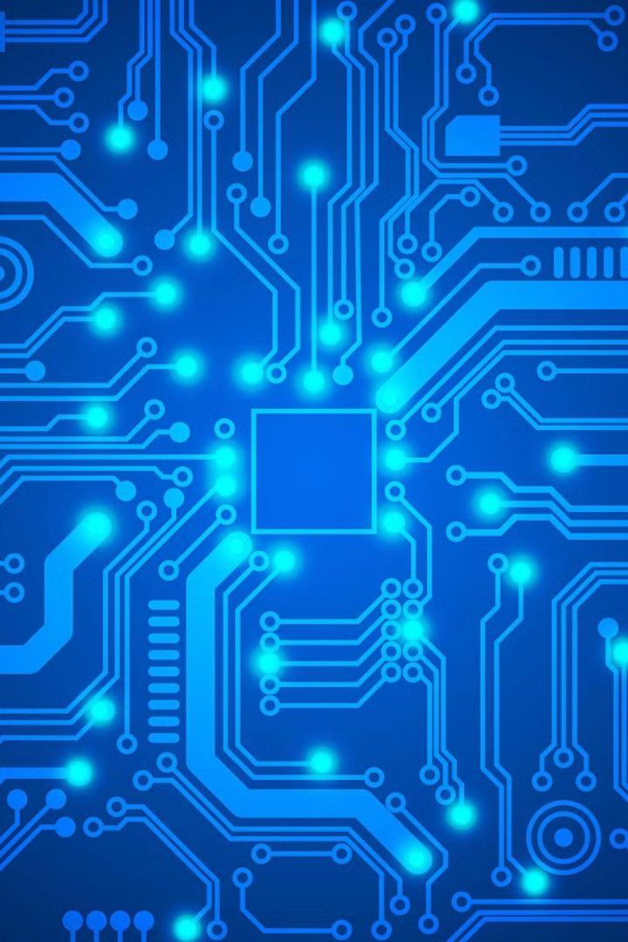
Introduction to Information Technology
Information technology (IT) is the use of computers, software, and networks to store, process, and transmit information. It encompasses a wide range of technologies that power our digital world, from hardware and software to networking and cybersecurity.
by Harshil Hirani
Smit Modi
Ha
Notes:
1

Slide 2
Hardware Components
Processors
Memory
Peripherals
The central processing unit (CPU) is the brain of a computer, responsible for executing instructions and performing calculations.
Random Access Memory (RAM) provides temporary storage for data and instructions, while storage devices like hard drives and solid-state drives provide long-term storage.
Peripherals include input devices like keyboards and mice, as well as output devices like monitors, printers, and speakers.
Notes:
2

Slide 3
Software and Operating Systems
System Software
2
Application Software
3
Programming Languages
Operating systems like Windows, macOS, and Linux provide the core functionality and manage system resources.
Productivity tools, media players, web browsers, and other apps allow users to accomplish specific tasks.
Languages like Python, Java, and JavaScript are used to create custom software and applications.
Notes:
3

Slide 4
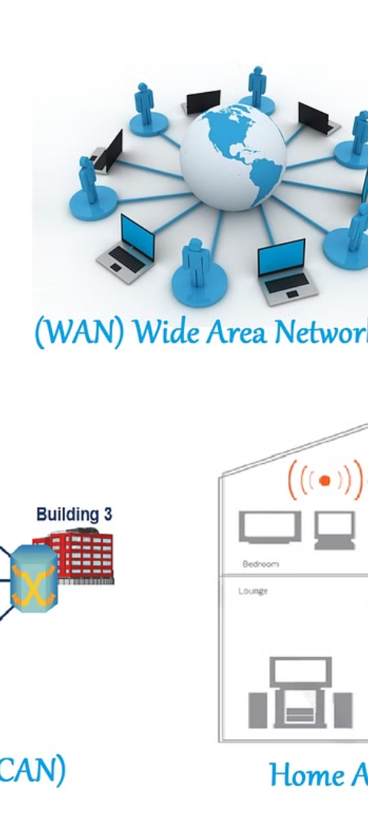
Networking and Communication
Local Area Networks (LANs)
LANs connect devices within a small geographic area, like a home or office.
2
Wide Area Networks (WANs)
WANs connect LANs over longer distances, enabling global communication and data sharing.
3
The Internet
The worldwide network of interconnected networks allows for global access to information and services.
Notes:
4

Slide 5
Cybersecurity and Data Protection
Threat Awareness
Data Encryption
Understand common cybersecurity threats like malware, phishing, and unauthorized access.
Encrypting sensitive data helps protect it from unauthorized access and theft.
Access Controls
Regular Backups
Implement strong password policies, multi-factor authentication, and user permissions to control access to systems and data.
Regularly backing up data ensures that it can be restored in the event of a security breach or system failure.
Notes:
5

Slide 6




Cloud Computing and Storage
Scalability
Accessibility
Cost-Efficiency
Reliability
Cloud services can quickly scale up or down to meet changing needs.
Data and applications are accessible from anywhere with an internet connection.
Cloud computing can reduce the need for on-premise hardware and IT staff.
Cloud providers offer redundant systems and robust backup solutions.
Notes:
6

Slide 7
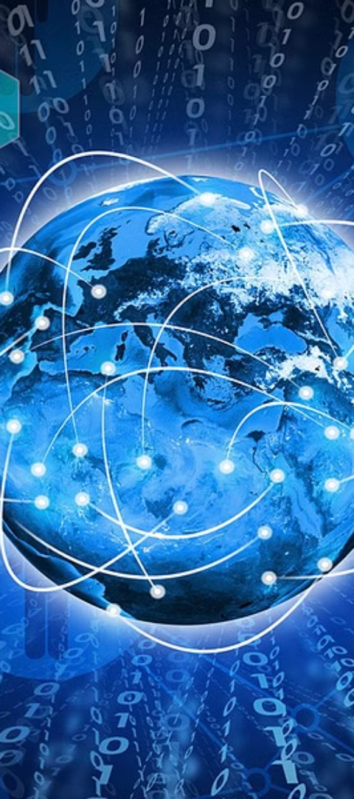

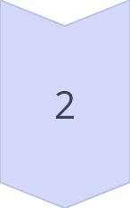
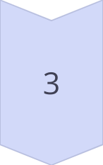
Emerging Technologies
Artificial Intelligence
AI systems can learn and make decisions without explicit programming.
Internet of Things (IoT)
Connected devices that can communicate and exchange data with each other.
Quantum Computing
Leveraging the principles of quantum mechanics to perform computations.
Notes:
7

Slide 8
Careers and Job Opportunities in IT
Software Developer
Designs and develops software applications.
Network Administrator
Responsible for maintaining and securing computer networks.
Cybersecurity Analyst
Identifies and mitigates cyber threats to protect an organization's systems and data.
Data Scientist
Analyzes and interprets complex data to uncover insights and drive decision-making.
Notes:
8

